Slide 1
Classifying noise sounds
Presented by:
Alanoud Alosaimi, Raghad Althunayan, Shaikha bin Ateeq

Slide 2
TABLE OF CONTENTS
01
02
03
04
INTRODUCTION
WORKFLOW
DATA STORY
TOOLS
05
06
07
08
FINAL RESULT
MODEL DEPLOYMENT
MODEL
ARCHITECTURE
FUTURE WORKS

Slide 3
Introduction
Sounds are all around us. Whether directly or indirectly. Sounds outline the context of our daily activities, conversations, music, noise . The human brain is continuously processing and understanding this audio data, so how the machine can understand it?
Goal:
Apply Deep Learning techniques to the classification of environmental sounds:
Assisting deaf individuals in their daily activities
Safety and security capabilities
Smart home use

Slide 4









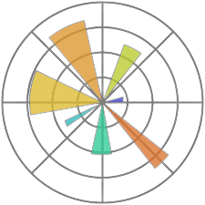

Tools
Tensorflow
Keras
Librosa
Hdf
Pickle
Numpy
Sklearn
Pandas
Matplotlib
PRO
Flask

Slide 5
workflow
Data
Data Preprocessing
Modeling
Data Preprocessing
Audio Augmentation
Padding
Data preprocessing
Data preprocessing
Modeling
Model Deployment

Slide 6
Data Story
Urban sounds classification
From kaggel
Row = 8733
Class label [10]=
Air Conditioner
Car Horn
Children Playing
Dog bark
Drilling
Engine Idling
Gun Shot
Jackhammer
Siren
Street Music

Slide 7
Data Story
Urban sounds classification
Noise sounds classification
+
Before = (8733 , 10)
From kaggel
From kaggel
After = (10904 , 21)
Row = 8733
Class label [10]=
Air Conditioner
Car Horn
Children Playing
Dog bark
Drilling
Engine Idling
Gun Shot
Jackhammer
Siren
Street Music
Row =2171
Class label [11]=
Applause
Keys_jangling
Telephone
Cough
Microwave_oven
Laughter
Tearing
Fireworks
Bus
Scissors
Computer_keyboard'
One dataset not enough
COMPLEXITY NEEDED!

Slide 8

Data Story
Audio Samples
Children playing
Drilling
Computer keyboard
Siren
Applause
Dog bark
Microwave oven
Telephone

Slide 9
We heard the audio samples, Do we know now its Properties ?

Slide 10
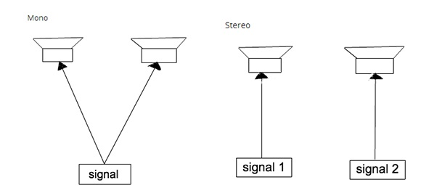
Audio Properties:
Audio Channels

Slide 11
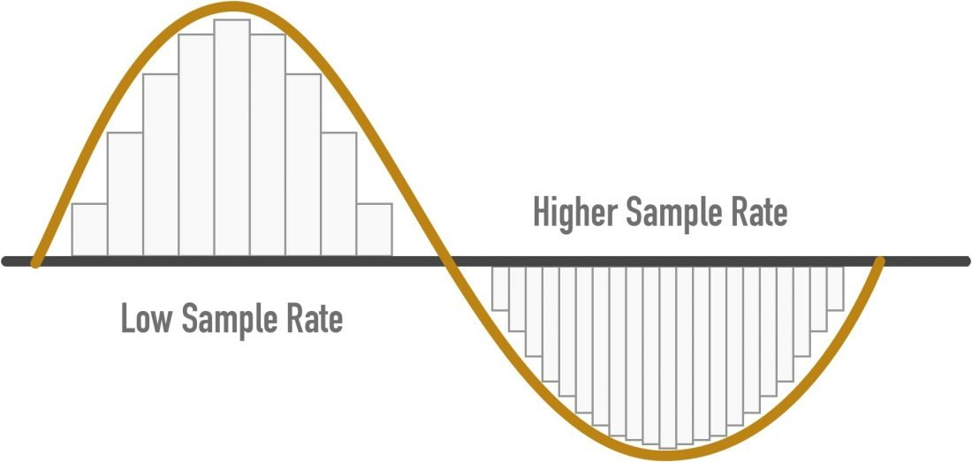
Audio Properties:
Sample Rate

Slide 12
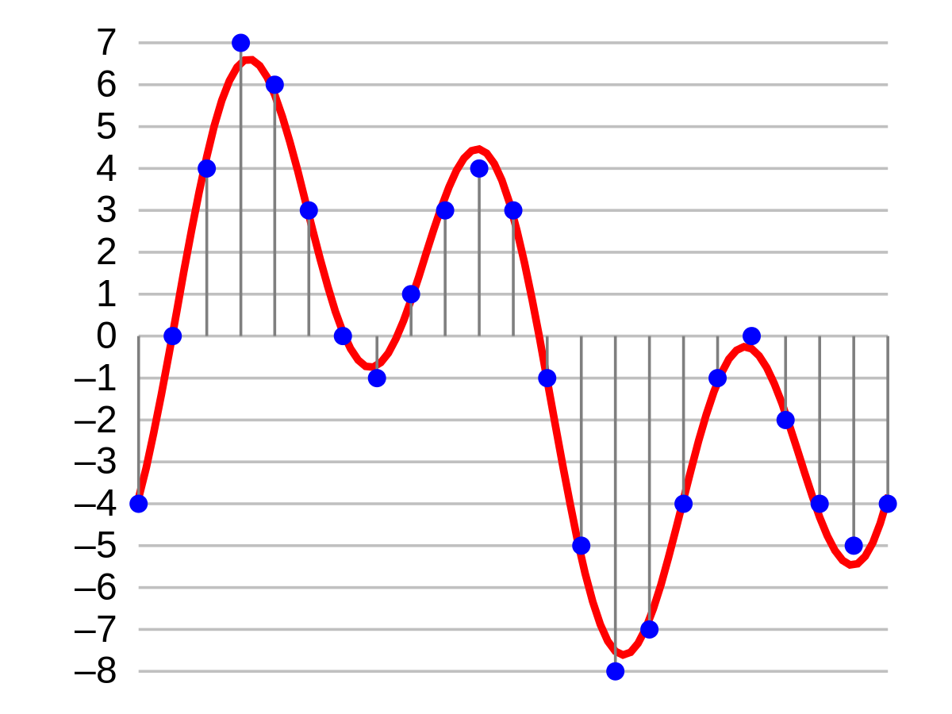
Audio Properties:
Bit-Depth

Slide 13
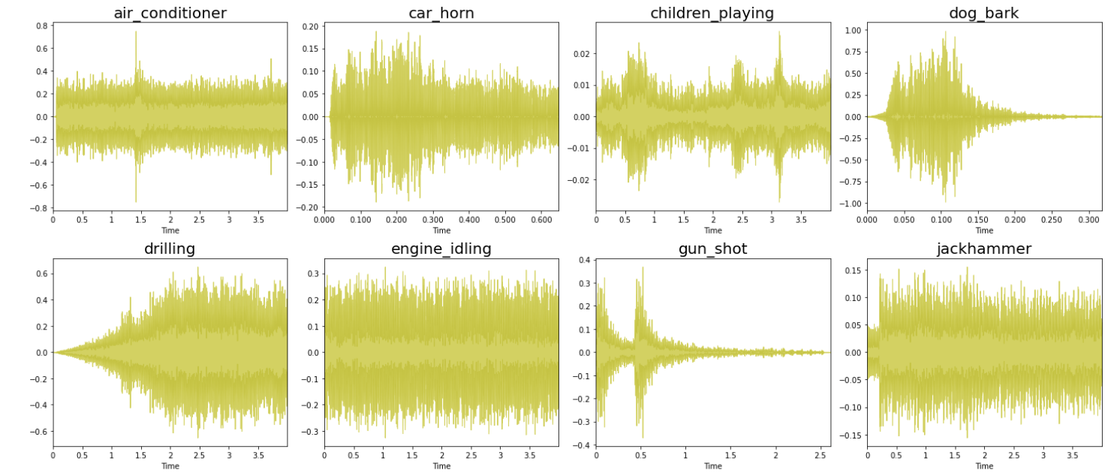
Waveplot

Slide 14
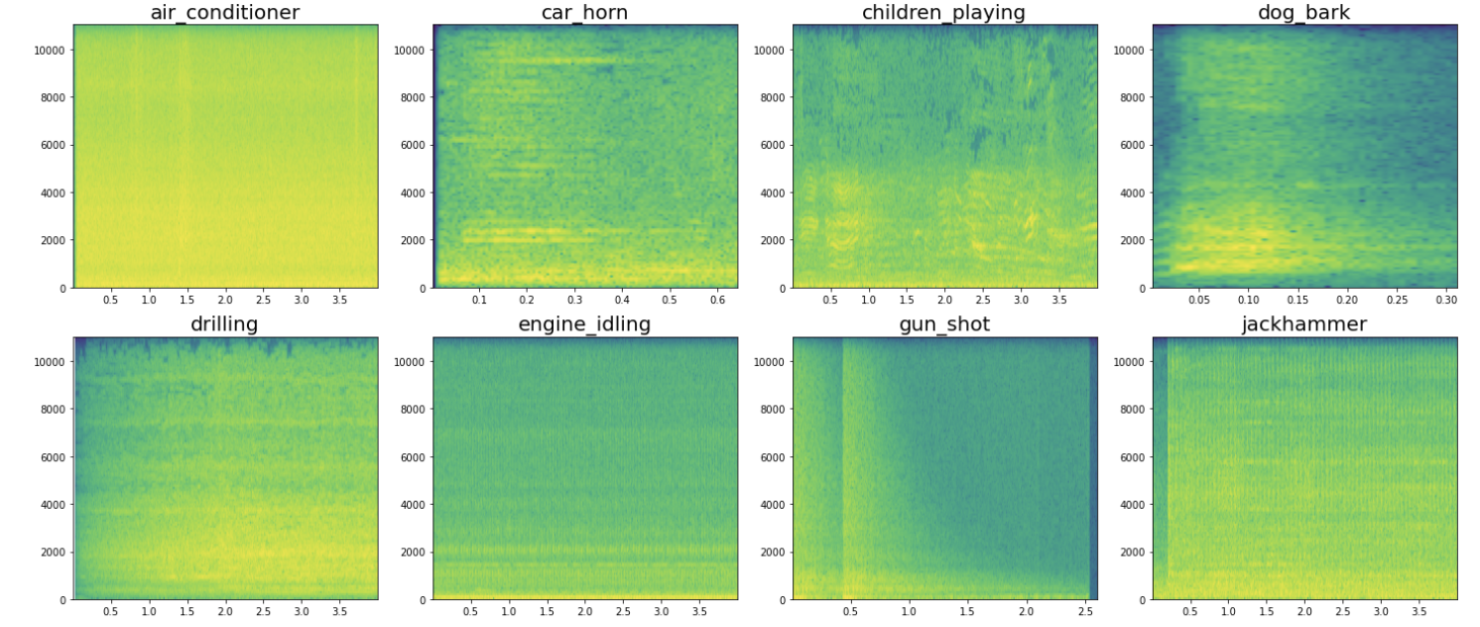
Specgram Plot

Slide 15
but!!
Can we use the spectrum images as input for our model? or something else?

Slide 16

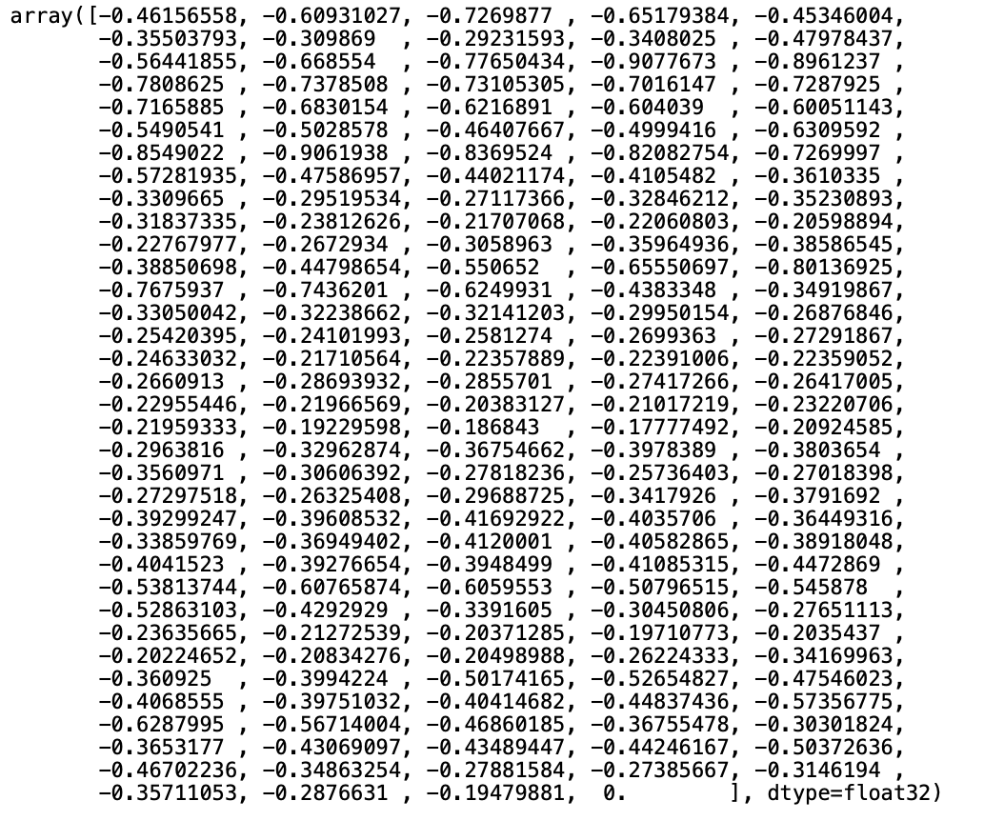
Feature Extraction Method: Mfcc
The MFCC summarises the frequency distribution across the window size, to analyse both the frequency and time characteristics of the sound. These audio representations will allow us to identify features for classification.

Slide 17
All we think data now is PERFECT!
But, the models didn't predict some classes (imbalanced data)

Slide 18
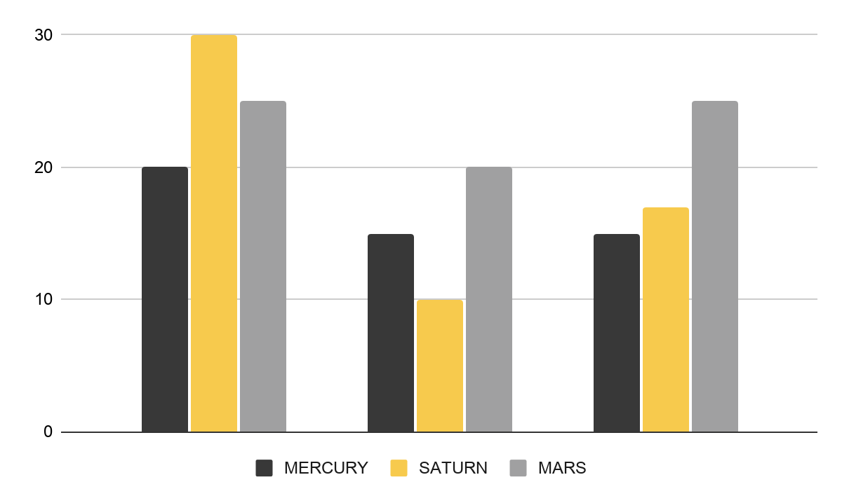
Classes Imbalanced
Solving Classes Imbalanced
Data Augmentation
The objective is to make our model invariant to those perturbations and enhance its ability to generalize.

Slide 19
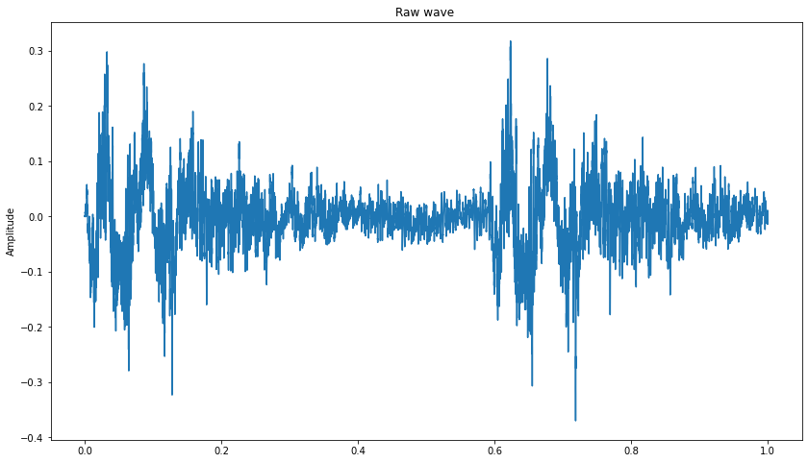
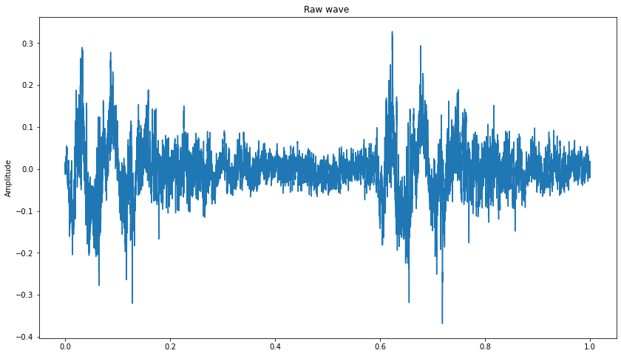
Data Augmentation:
Noise
Orignal
Noise

Slide 20
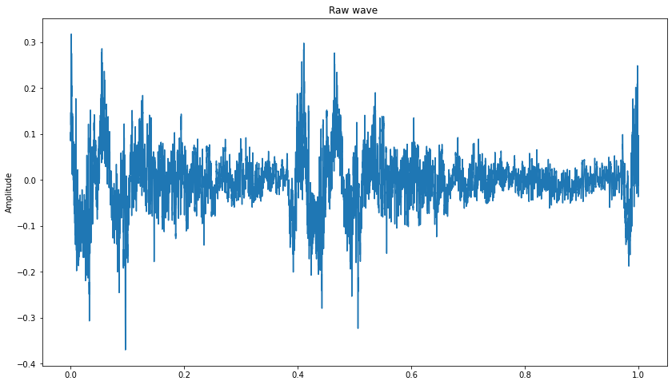
Data Augmentation:
Shifting the Audio
Orignal
Shifting

Slide 21
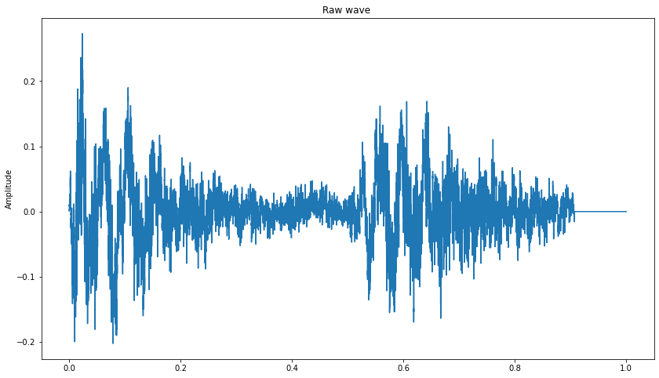
Data Augmentation:
Time stretching (changing play time)
Orignal
Stretching

Slide 22
Data Augmentation
Initial data
New data
Merged data
10903
54515
65418
(10903, 21)
(65418, 21)

Slide 23
solving didn't enough!..WHY?

Slide 24


Padding
Length sounds problem
Least length (fram_num = 174)
Longest length (fram_num = 1292)
Least , why?

Slide 25
Split size
Train :=0.8
Test:0.2
Train :=0.75
Validations:0.25

Slide 26
Models result (1)
 | Train acc | Val acc | Epochs | batch
Beasline | 0.61 | 0.45 | 500 | 50
Cnn2 (1) | 0.28 | 0.25 | 200 | 50
Cnn2 (2) | 0.60 | 0.44 | 1000 | 50
Cnn2 (3) | 0.33 | 0.21 | 300 | 300
Cnn2 (4) | 0.48 | 0.44 | 500 | 50

Slide 27
Models result (2)
 | Train acc | Val acc | Epochs | batch
Beasline | 0.69 | 0.63 | 500 | 50
Cnn2D (1) | 0.80 | 0.77 | 300 | 300
Cnn2d (2) | 0.89 | 0.78 | 300 | 300
Cnn2d (3) | 0.81 | 0.75 | 300 | 300
Cnn1d | 0.27 | 0.3 | 500 | 50
lstm | 0.3 | 0.34 | 500 | 50

Slide 28
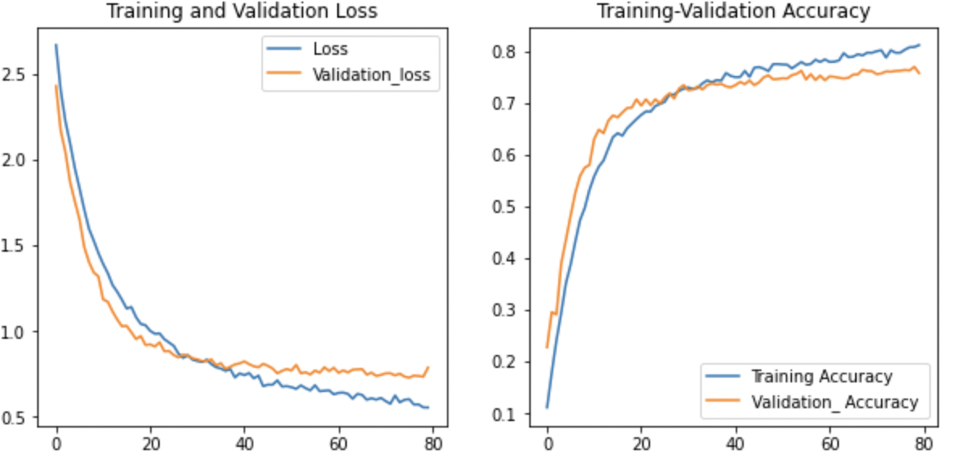
FINAL RESULT
Train acc= 0.81
Val acc= 0.75
test acc= 0.77

Slide 29
MODEL ARCHITECTURE
Conv2D (Filter size = 128)
MaxPooling2D
Conv2D (Filter size = 128)
MaxPooling2D
Droupout (0.8)
Flatten
Dense (512, activation = ‘relu’)
Droupout (0.8)
Dense (512, activation = ‘relu’)
Droupout (0.8)
Dense (18, activation = softmax)

Slide 30
Challenges
Merge two dataset
Audio data
Jupiter
Run
Ram crash
Long time

Slide 31
Future work
build an app that helps the deaf in their daily life
Transfer Learning

Slide 32
Model Deployment
Demo

Slide 33
Thanks!

